Slide 1
Pipelining

Slide 2
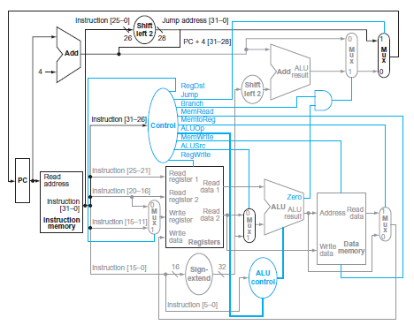
Single cycle Full Datapath
Chapter 4 — The Processor — <number>
Notes:
Morgan Kaufmann Publishers
Chapter 4 — The Processor

Slide 3
Single cycle implementation
Also called single clock cycle implementation
An implementation in which an instruction is executed in one clock cycle
Advantage
  Easy to understand
Disadvantage
  it is too slow to be practical
Why?

Slide 4
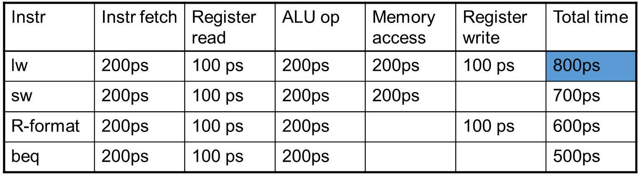
Performance - Single cycle
Assume time for stages is
  100ps for register read or write
  200ps for other stages
What is the total time for the following instructions?
Chapter 4 — The Processor — <number>

Slide 5
Performance Issues Single cycle
The clock cycle must have the same length for every instruction
The path having longest delay determines the clock cycle length (time/period)
  Critical path: load instruction
  Instruction memory → register file → ALU → data memory → register file
Although the CPI is 1; the overall performance of a single-cycle implementation is likely to be poor, since the clock cycle is too long

Slide 6
Performance Issues Single cycle
Solution:
  improve performance by pipelining
  Similar datapath and higher throughput
Pipelining is an implementation technique
Improves efficiency by executing multiple instructions simultaneously
Chapter 4 — The Processor — <number>
Notes:
Morgan Kaufmann Publishers
Chapter 4 — The Processor

Slide 7
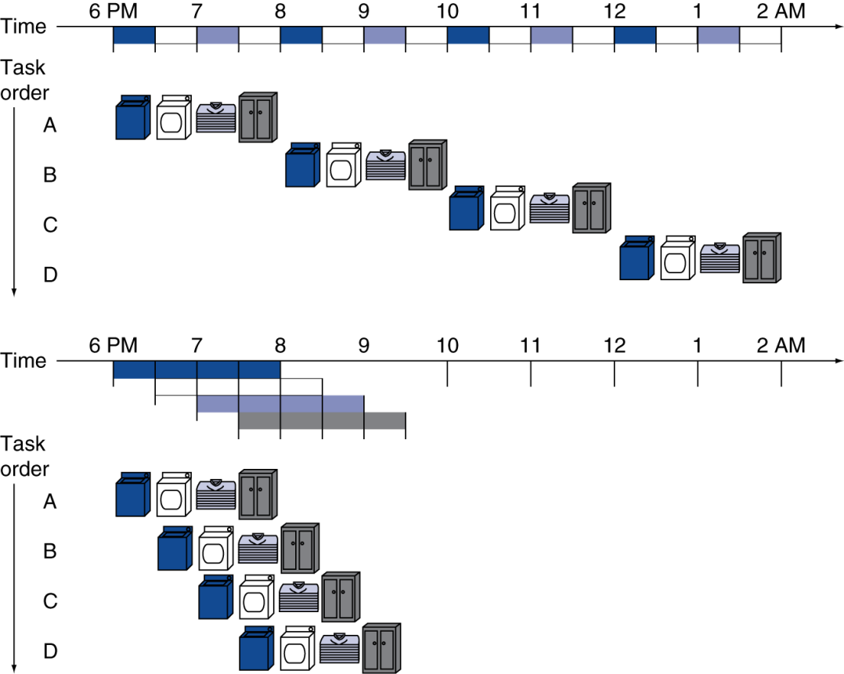
Pipelining Analogy
Pipelined laundry: overlapping execution
  Parallelism improves performance
§4.5 An Overview of Pipelining
Chapter 4 — The Processor — <number>
Notes:
Morgan Kaufmann Publishers
Chapter 4 — The Processor

Slide 8
MIPS Pipeline
Five stages, one step per stage
  IF: Instruction fetch from memory
  ID: Instruction decode & register read
  EX: Execute operation or calculate address
  MEM: Access memory operand
  WB: Write result back to register
Chapter 4 — The Processor — <number>
Notes:
Morgan Kaufmann Publishers
Chapter 4 — The Processor

Slide 9
Pipeline Performance
Assume time for stages is
  100ps for register read or write, 200ps for other stages
Compare pipelined datapath with single-cycle datapath
Clock cycle time = 800 ps
Instr | Instr fetch | Register read | ALU op | Memory access | Register write | Total time
lw | 200ps | 100 ps | 200ps | 200ps | 100 ps | 800ps
sw | 200ps | 100 ps | 200ps | 200ps |  | 700ps
R-format | 200ps | 100 ps | 200ps |  | 100 ps | 600ps
beq | 200ps | 100 ps | 200ps |  |  | 500ps
Chapter 4 — The Processor — <number>
Notes:
Morgan Kaufmann Publishers
Chapter 4 — The Processor

Slide 10
Pipeline Speedup
If all stages are balanced or even (i.e., all take the same time)
Pipeline speedup (ideal )= No. of stages
  Time per instruction_{pipelined}
  = Time per instruction_{nonpipelined} /Number of stages
If stages are not balanced or uneven, speedup is less
Chapter 4 — The Processor — <number>
Notes:
Morgan Kaufmann Publishers
Chapter 4 — The Processor

Slide 11
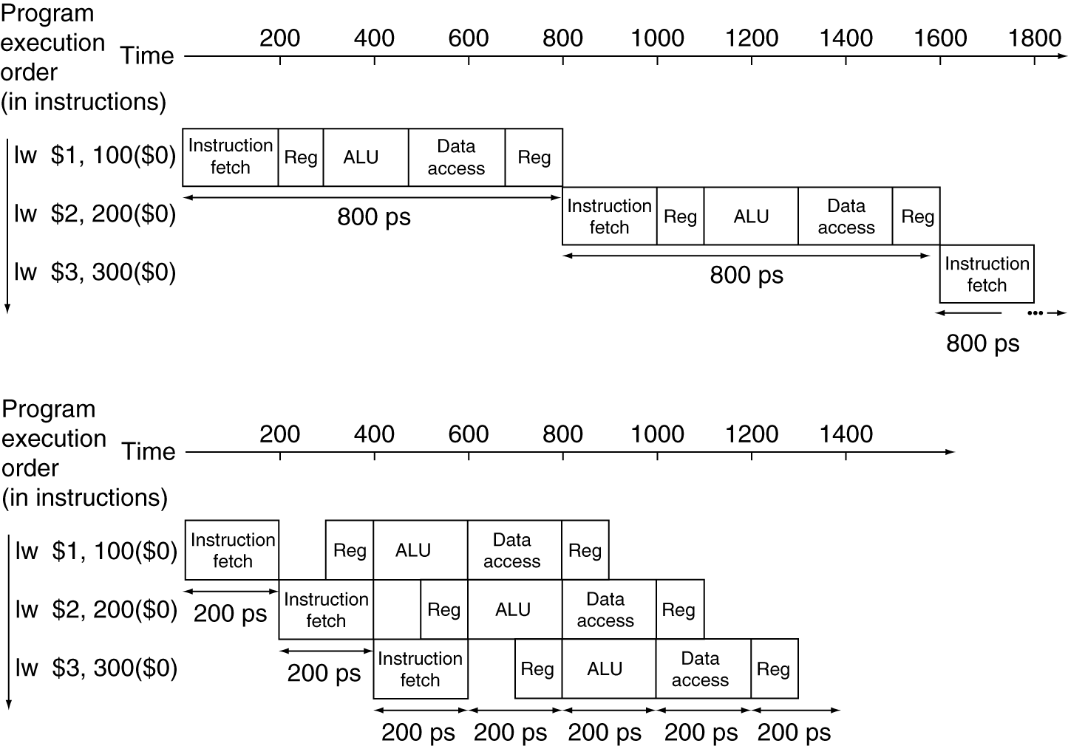
Pipeline Performance
Single-cycle (T_{c}= 800ps)
Chapter 4 — The Processor — <number>
Notes:
Morgan Kaufmann Publishers
Chapter 4 — The Processor

Slide 12
Pipeline Performance
Pipeline speedup (ideal) = No. of stages
  Time per instruction_{pipelined}
  = Time per instruction_{nonpipelined} /Number of stages
  Time per instruction_{pipelined} = 800/5 = 160 ps
But clock cycle time cannot be 160 ps as some stages need 200ps
Therefore the longest stage determines the clock cycle time of the pipeline
In this case the clock cycle time for pipeline is 200ps
Chapter 4 — The Processor — <number>

Slide 13
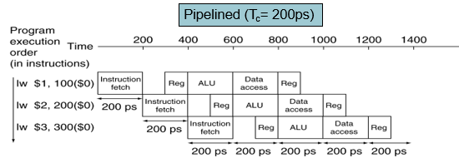
Pipeline Performance
Chapter 4 — The Processor — <number>

Slide 14
Pipeline Performance
Now compute Pipeline speedup
Time per instruction_{pipelined}
  = Time per instruction_{nonpipelined} /Number of stages
  Speedup = 800/200 = 4
Therefore it is not possible to achieve the maximum speedup of 5 due to uneven pipeline stages.!!!
Chapter 4 — The Processor — <number>

Slide 15
Pipeline Performance
Single-cycle (T_{c}= 800ps)
Pipelined (T_{c}= 200ps)
Chapter 4 — The Processor — <number>

Slide 16
Pipeline Performance
Observe the speedup for the three instructions:
  Speedup = 2400 ps / 1400 ps = 12/7 = 1.7
Therefore, it is not possible to achieve the maximum speedup because the number of instructions is not large!!!
Let’s add 1,000,000 instructions to the pipeline
Each instruction adds 200 ps to the total execution time
Chapter 4 — The Processor — <number>

Slide 17

Pipeline Performance
The total execution time would be
  1,000,000 × 200 ps + 1400 ps, or 200,001,400 ps
In the nonpipelined example, we would add 1,000,000 instructions, each taking 800 ps
The total execution time would be
  1,000,000 × 800 ps + 2400 ps, or 800,002,400 ps
The ratio of total execution times:
Therefore, speedup is due to increased throughput
  Latency (time for each instruction) does not decrease
Chapter 4 — The Processor — <number>

Slide 18
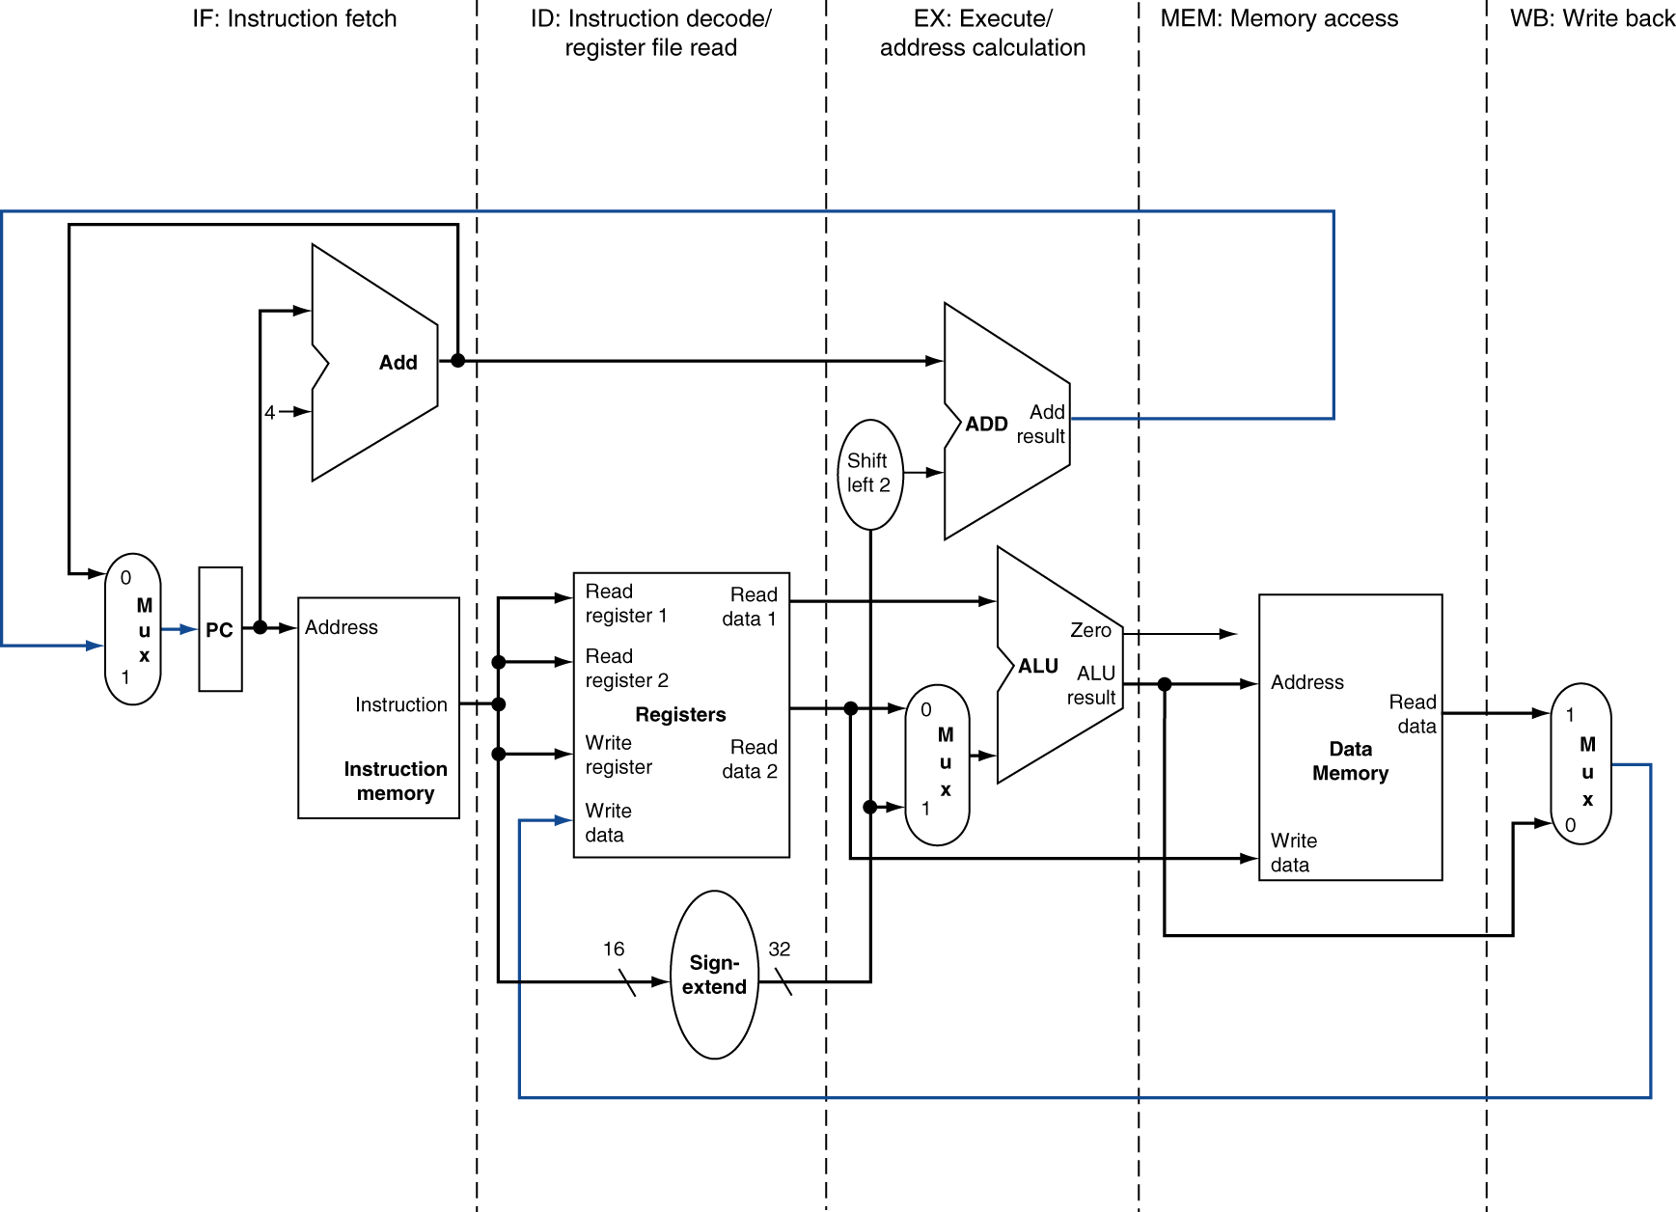
MIPS Pipelined Datapath
§4.6 Pipelined Datapath and Control
MEM
Right-to-left flow leads to hazards
WB
Chapter 4 — The Processor — <number>
Notes:
Morgan Kaufmann Publishers
Chapter 4 — The Processor

Slide 19
Register File
Only takes half of a cycle to read or write to register file
Convention:
    Write 1st half of cycle
  Read 2nd half of cycle
Chapter 4 — The Processor — <number>

Slide 20
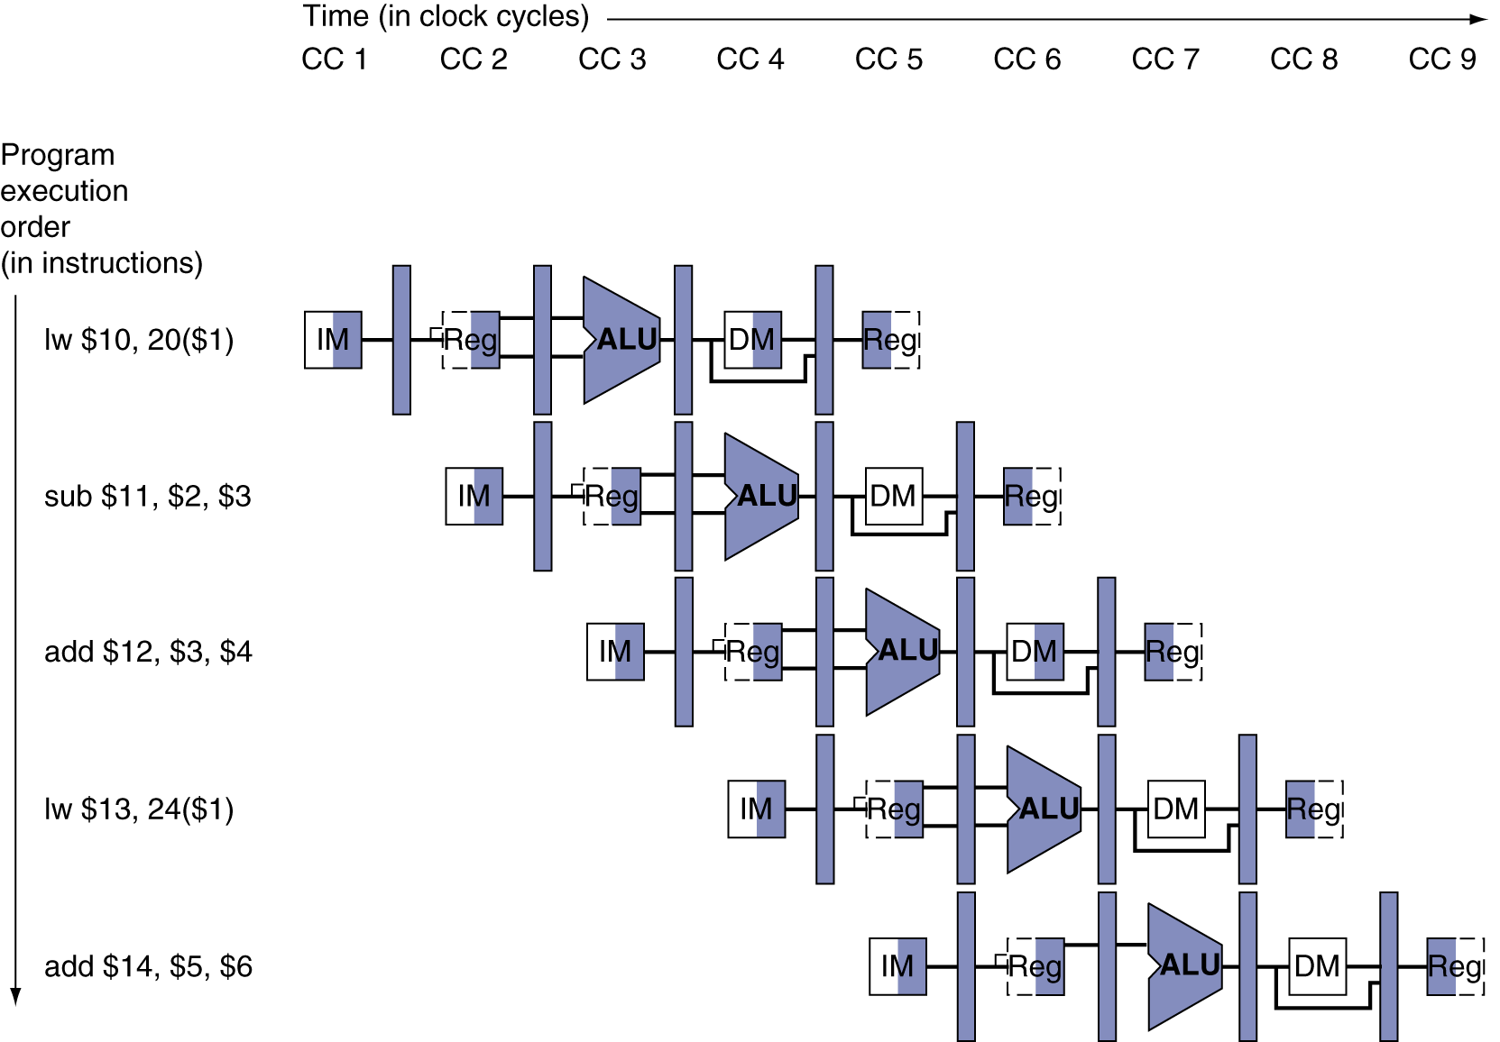
Multi-Cycle Pipeline Diagram
Form showing resource usage
Chapter 4 — The Processor — <number>
Notes:
Morgan Kaufmann Publishers
Chapter 4 — The Processor

Slide 21
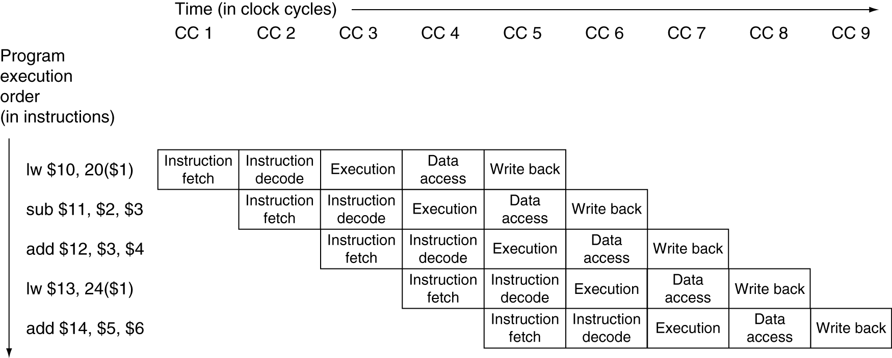
Multi-Cycle Pipeline Diagram
Traditional form
Chapter 4 — The Processor — <number>
Notes:
Morgan Kaufmann Publishers
Chapter 4 — The Processor

Slide 22
Hazards
Situations that prevent executing the next instruction in the following (next) clock cycle
Structure hazards
  Instruction cannot execute because a required resource (hardware) is busy
Data hazard
  Instruction cannot execute because data required to execute instruction is not available. Need to wait for data
Chapter 4 — The Processor — <number>
Notes:
Morgan Kaufmann Publishers
Chapter 4 — The Processor

Slide 23
Hazards
Control or Branch hazard
  Instruction cannot execute because the instruction that was fetched is not the one that is needed.
Hazards results in pipeline stall or bubble
Chapter 4 — The Processor — <number>

Slide 24
Structural Hazards
Conflict for use of a resource
In MIPS pipeline with a single memory for instructions and data
  Two instructions may access the memory at the same clock cycle resulting in resource conflict
Hence, pipelined datapaths require separate instruction/data memories
Chapter 4 — The Processor — <number>
Notes:
Morgan Kaufmann Publishers
Chapter 4 — The Processor

Slide 25
Structural Hazards
Chapter 4 — The Processor — <number>

Slide 26
Data Hazards
An instruction depends on data supplied by a previous instruction
Consider the following instructions and their execution in the pipeline
  add $s0, $t0, $t1
  sub $t2, $s0, $t3
Chapter 4 — The Processor — <number>
Notes:
Morgan Kaufmann Publishers
Chapter 4 — The Processor

Slide 27
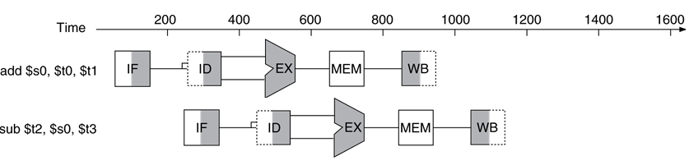
Data Hazards
Arrow to the left is
information passed
backwards in time. Which cannot happen.
In what cycle does the add write $s0
  1st half of cycle 5
In what cycle does the sub read $s0?
  2nd half of cycle 3
Without intervention, a data hazard could severely stall the pipeline. Stall - wasted cycles
Chapter 4 — The Processor — <number>

Slide 28
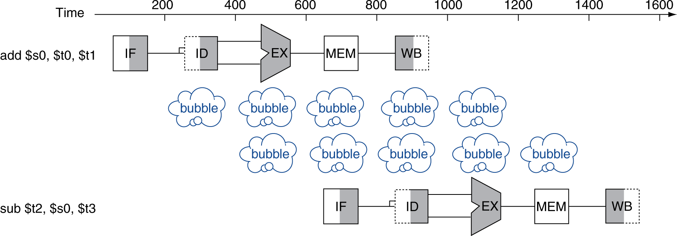
Data Hazards
An instruction depends on data supplied by a previous instruction which is still in pipeline
  add $s0, $t0, $t1
  sub $t2, $s0, $t3
Chapter 4 — The Processor — <number>
Notes:
Morgan Kaufmann Publishers
Chapter 4 — The Processor

Slide 29
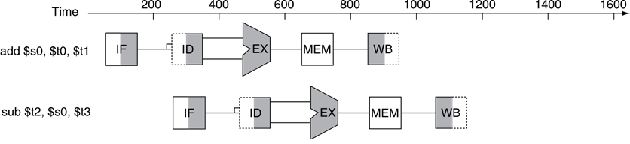
Solution1: Forwarding (aka Bypassing)
In what cycle is $s0 calculated in the machine? end of cycle 3
In what cycle is $s0 used? beginning of cycle 4
Use extra connections in the datapath to retrieve the missing item early from internal resources than waiting for it to be available from programmer visible memory or registers
Chapter 4 — The Processor — <number>
Notes:
Morgan Kaufmann Publishers
Chapter 4 — The Processor

Slide 30
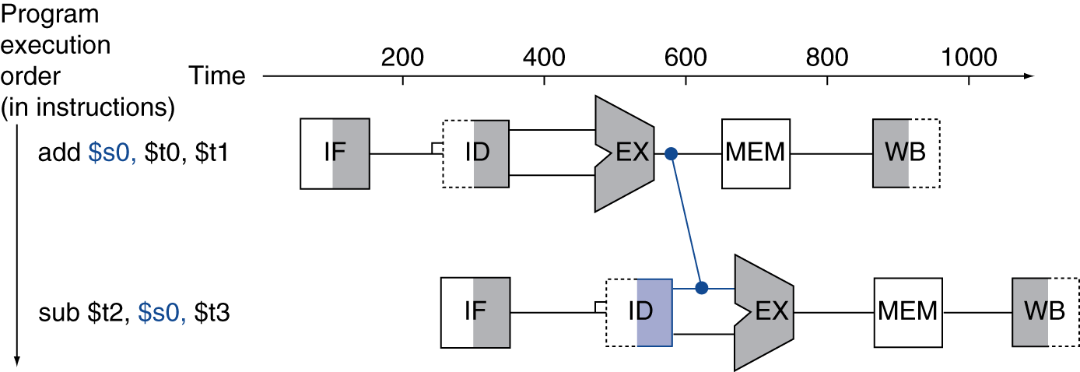
Forwarding (aka Bypassing)
Forwarding paths are valid only if the destination stage is later in time than the source stage
Chapter 4 — The Processor — <number>

Slide 31
Load-Use Data Hazard
Can’t always avoid stalls by forwarding
  If value not computed when needed
  Can’t forward backward in time!
A specific form of data hazard in which the data being loaded by a load instruction has not yet become available when it is needed by another instruction
  lw $s0, 20($t1)
  sub $t2, $s0, $t3
Chapter 4 — The Processor — <number>
Notes:
Morgan Kaufmann Publishers
Chapter 4 — The Processor

Slide 32
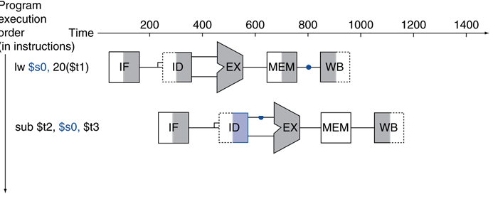
Load-Use Data Hazard
In what cycle does the lw write $s0
  1st half of cycle 5
In what cycle does the sub read $s0?
  2nd half of cycle 3
Chapter 4 — The Processor — <number>

Slide 33
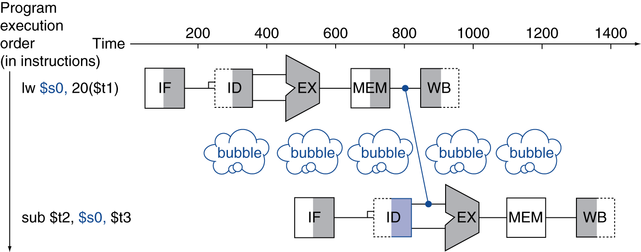
Load-Use Data Hazard
In what cycle is $s0 calculated in the machine? End of cycle 4
In what cycle is $s0 used? beginning of cycle 5
  A stall of 1 clock cycle
Chapter 4 — The Processor — <number>
Notes:
Morgan Kaufmann Publishers
Chapter 4 — The Processor

Slide 34
Solution2: Code Scheduling to Avoid Stalls
Reorder code to avoid use of load result in the next instruction
C code for A = B + E; C = B + F;
A, B, C, E, F are all present in memory
B in $t1, E in $t2,
A in $t3, F in $t4
C in $t5
B
E
F
A
C
lw $t1, 0($t0)
lw $t2, 4($t0)
add $t3, $t1, $t2
sw $t3, 12($t0)
lw $t4, 8($t0)
add $t5, $t1, $t4
sw $t5, 16($t0)
Chapter 4 — The Processor — <number>
Notes:
Morgan Kaufmann Publishers
Chapter 4 — The Processor

Slide 35
Solution2: Code Scheduling to Avoid Stalls
Reorder code to avoid use of load result in the next instruction
lw $t1, 0($t0)
lw $t2, 4($t0)
add $t3, $t1, $t2
sw $t3, 12($t0)
lw $t4, 8($t0)
add $t5, $t1, $t4
sw $t5, 16($t0)
lw $t1, 0($t0)
lw $t2, 4($t0)
lw $t4, 8($t0)
add $t3, $t1, $t2
sw $t3, 12($t0)
add $t5, $t1, $t4
sw $t5, 16($t0)
stall
stall
13 cycles
11 cycles
Chapter 4 — The Processor — <number>
Notes:
Morgan Kaufmann Publishers
Chapter 4 — The Processor

Slide 36
Control Hazards
Branch determines flow of control
  Fetching next instruction depends on branch outcome
  Pipeline can’t always fetch correct instruction
  In MIPS design, the decision about whether to branch doesn’t occur until the MEM pipeline stage
  This delay in determining the proper instruction to fetch is called a control hazard or branch hazard
Chapter 4 — The Processor — <number>
Notes:
Morgan Kaufmann Publishers
Chapter 4 — The Processor

Slide 37
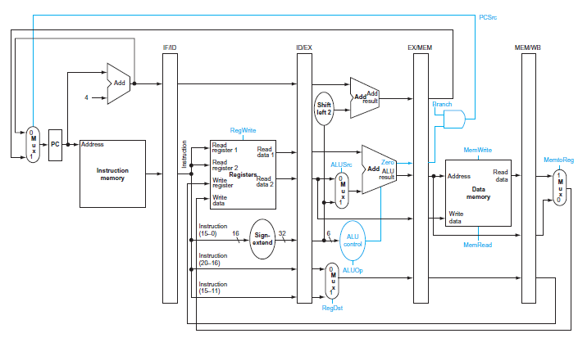
Pipelined datapath
Chapter 4 — The Processor — <number>

Slide 38
Control Hazards
In MIPS pipeline for branch instructions
  Need to compare registers
  Compute target address
  Update PC
Add hardware to do it in ID stage
Chapter 4 — The Processor — <number>

Slide 39
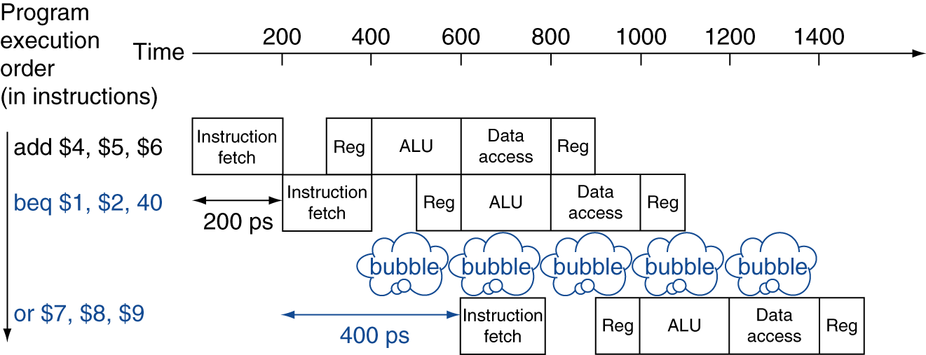
Solution 1: Stall on Branch
Wait until branch outcome is determined before fetching next instruction
    1 clock cycle is wasted
Chapter 4 — The Processor — <number>
Notes:
Morgan Kaufmann Publishers
Chapter 4 — The Processor

Slide 40
Solution 2: Branch Prediction
Used when unable to resolve the branch in the second stage
  Happens in deeper pipelines
  Larger slowdown if we stall
Predict outcome of branch
  Only stall if prediction is wrong
Types
  Static branch prediction
  Dynamic branch prediction
Chapter 4 — The Processor — <number>
Notes:
Morgan Kaufmann Publishers
Chapter 4 — The Processor

Slide 41
Static branch prediction
Simple approach:
  Predict branches not taken
  Fetch instruction after branch, with no delay
  Does not slow down the pipeline when you are correct
  Flush (discard wrongly fetched instruction) the pipeline when we are wrong
  If branches are untaken half the time, and if it costs little to discard the instructions, this optimization halves the cost of control hazards
Drawbacks
  Not suitable for deeper or aggressive (multiple issue) pipelines
Chapter 4 — The Processor — <number>

Slide 42
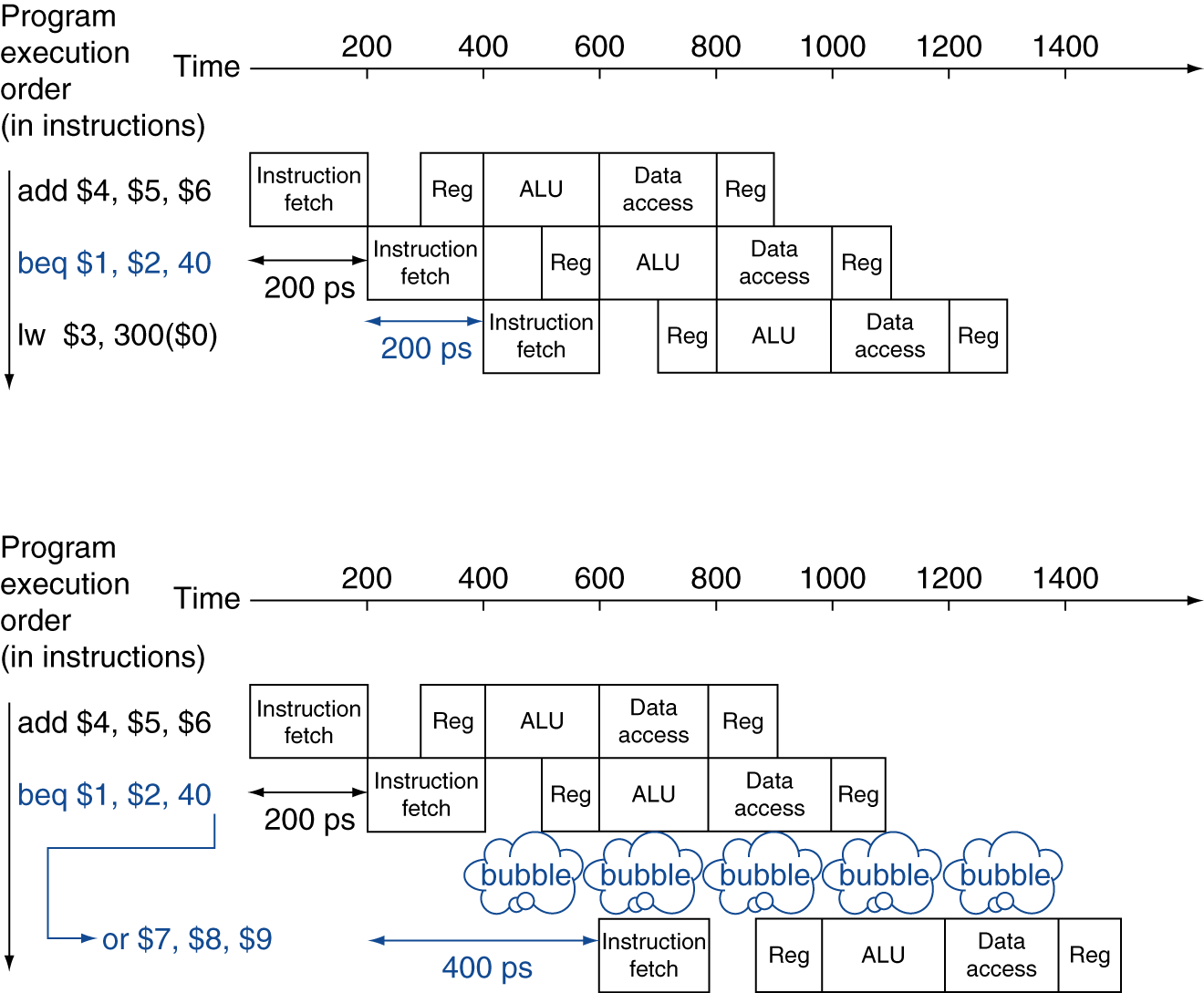
MIPS with Predict Not Taken
Prediction correct
Prediction incorrect
Chapter 4 — The Processor — <number>
Notes:
Morgan Kaufmann Publishers
Chapter 4 — The Processor

Slide 43
Dynamic branch prediction
  Make guess depending on the behavior of each branch
  Change predictions for a branch over the life of a program using hardware
  Branch prediction buffer (aka branch history table)
    Indexed by recent branch instruction addresses
    Stores outcome (taken/not taken)
  To execute a branch
    Check table, expect the same outcome
    Depending on outcome start fetching from fall-through or target
    If prediction was wrong, flush pipeline and flip prediction
Chapter 4 — The Processor — <number>

Slide 44
Single/One bit predictor
Uses only one bit
  0 indicates branch not taken (NT)
  1 indicates branch taken (T)
Consider a loop branch that branches nine times in a row, then is not taken once. What is the prediction accuracy for this branch under steady-state prediction behaviour using single bit predictor assuming the prediction bit for this branch remains in the prediction buffer?
Chapter 4 — The Processor — <number>

Slide 45
Solution
Mispredict on the first and last loop iterations
% of times the branch is taken = 90%
Total predictions = 10
Correct predictions = 8
Accuracy = 80%
 | 1 | 2 | 3 | 4 | 5 | 6 | 7 | 8 | 9 | 10
Actual outcome | T | T | T | T | T | T | T | T | T | NT
Predicted outcome | 0 | 1 | 1 | 1 | 1 | 1 | 1 | 1 | 1 | 1
Outcome bit in BHT | 0 - 1 | 1 | 1 | 1 | 1 | 1 | 1 | 1 | 1 | 1 - 0
Chapter 4 — The Processor — <number>

Slide 46
Two bit predictor
In a 2-bit scheme, a prediction must be wrong twice before it is changed
States | Description | Outcome
00 | Strong NT | NT
01 | Weak NT | NT
10 | Week T | T
11 | Strong T | T
Chapter 4 — The Processor — <number>

Slide 47
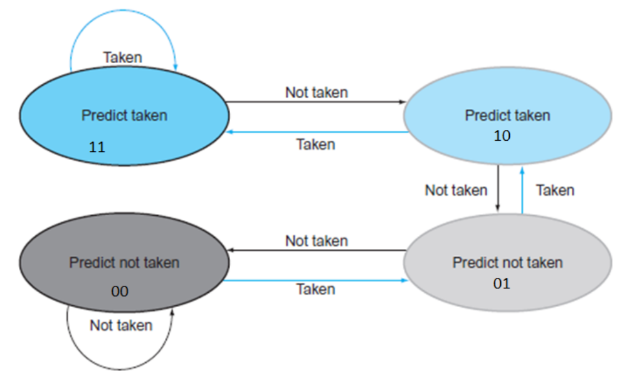
Two bit predictor
Finite-state machine
Chapter 4 — The Processor — <number>

Slide 48
Question
Consider a loop branch that branches nine times in a row, then is not taken once. What is the prediction accuracy for this branch under steady-state prediction behaviour using two bit predictor assuming the prediction bit for this branch remains in the prediction buffer?
Chapter 4 — The Processor — <number>

Slide 49
Solution
Mispredict on the last loop iteration
% of times the branch is taken = 90%
Total predictions = 10
Correct predictions = 9
Accuracy = 90%
 | 1 | 2 | 3 | 4 | 5 | 6 | 7 | 8 | 9 | 10
Actual outcome | T | T | T | T | T | T | T | T | T | NT
Predicted outcome | 1 | 1 | 1 | 1 | 1 | 1 | 1 | 1 | 1 | 1
Outcome bit in BHT | 10 - 11 | 11 | 11 | 11 | 11 | 11 | 11 | 11 | 11 | 11 - 10
Chapter 4 — The Processor — <number>

Slide 50
Solution 3: Delayed Branching
In the MIPS CPU, the outcome of the branch is delayed by one instruction
The slot directly after a delayed branch instruction is called branch delay slot
Compilers and assemblers try to place an instruction that always executes after the branch in the branch delay slot
The job of the software is to make the successor instructions valid and useful
This optimization is legal only if the the program executes correctly
Chapter 4 — The Processor — <number>

Slide 51
Solution 3: Delayed Branching
Scheduling branch delay slots
  Based on the place from where instructions that are scheduled into the delay slots
    From before
    From target
    From fall-through
Chapter 4 — The Processor — <number>

Slide 52

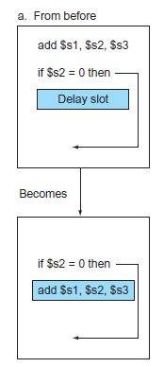
Solution 3: Delayed Branching
The delay slot is scheduled with an independent instruction from before the branch
best choice
Chapter 4 — The Processor — <number>

Slide 53
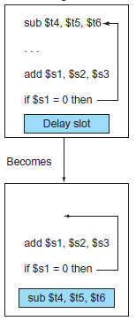
Solution 3: Delayed Branching
In the code sequence the use of $s1 in the branch condition prevents the add instruction (whose destination is $s1) from being moved into the branch delay slot.
the branch delay slot is scheduled from the target of the branch
preferred when the branch is taken with high probability
Chapter 4 — The Processor — <number>

Slide 54
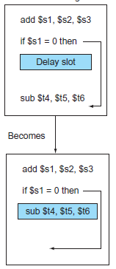
Solution 3: Delayed Branching
In the code sequence the use of $s1 in the branch condition prevents the add instruction (whose destination is $s1) from being moved into the branch delay slot.
The branch delay slot is scheduled from the fall-through of the branch
Chapter 4 — The Processor — <number>

Slide 55
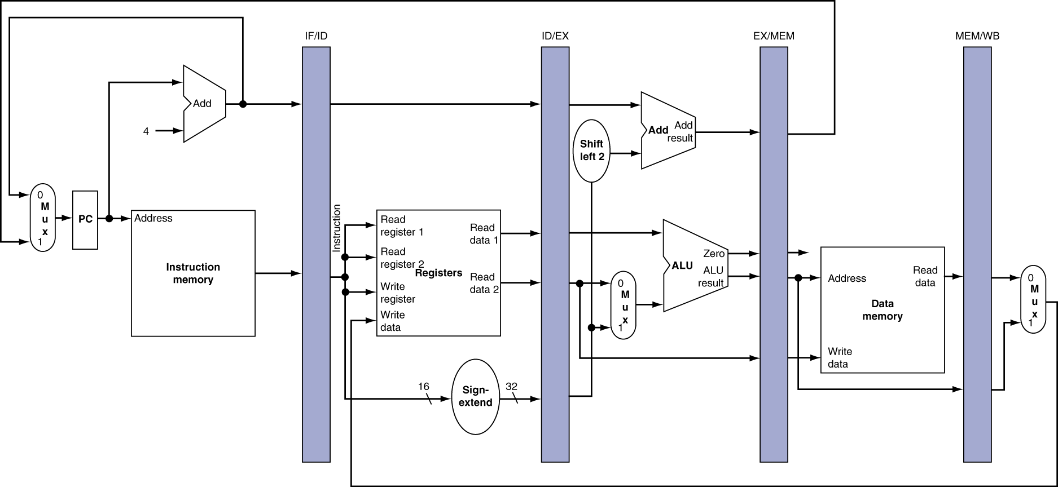
Pipeline registers
Need registers between stages
  To hold information produced in previous cycle
Chapter 4 — The Processor — <number>
Notes:
Morgan Kaufmann Publishers
Chapter 4 — The Processor

Slide 56
Pipeline Operation
Cycle-by-cycle flow of instructions through the pipelined datapath
  “Single-clock-cycle” pipeline diagram
    Shows pipeline usage in a single cycle
    Highlight resources used
  “Multi-clock-cycle” diagram
    Graph of operation over time
We’ll look at “single-clock-cycle” diagrams for load & store
Chapter 4 — The Processor — <number>
Notes:
Morgan Kaufmann Publishers
Chapter 4 — The Processor

Slide 57
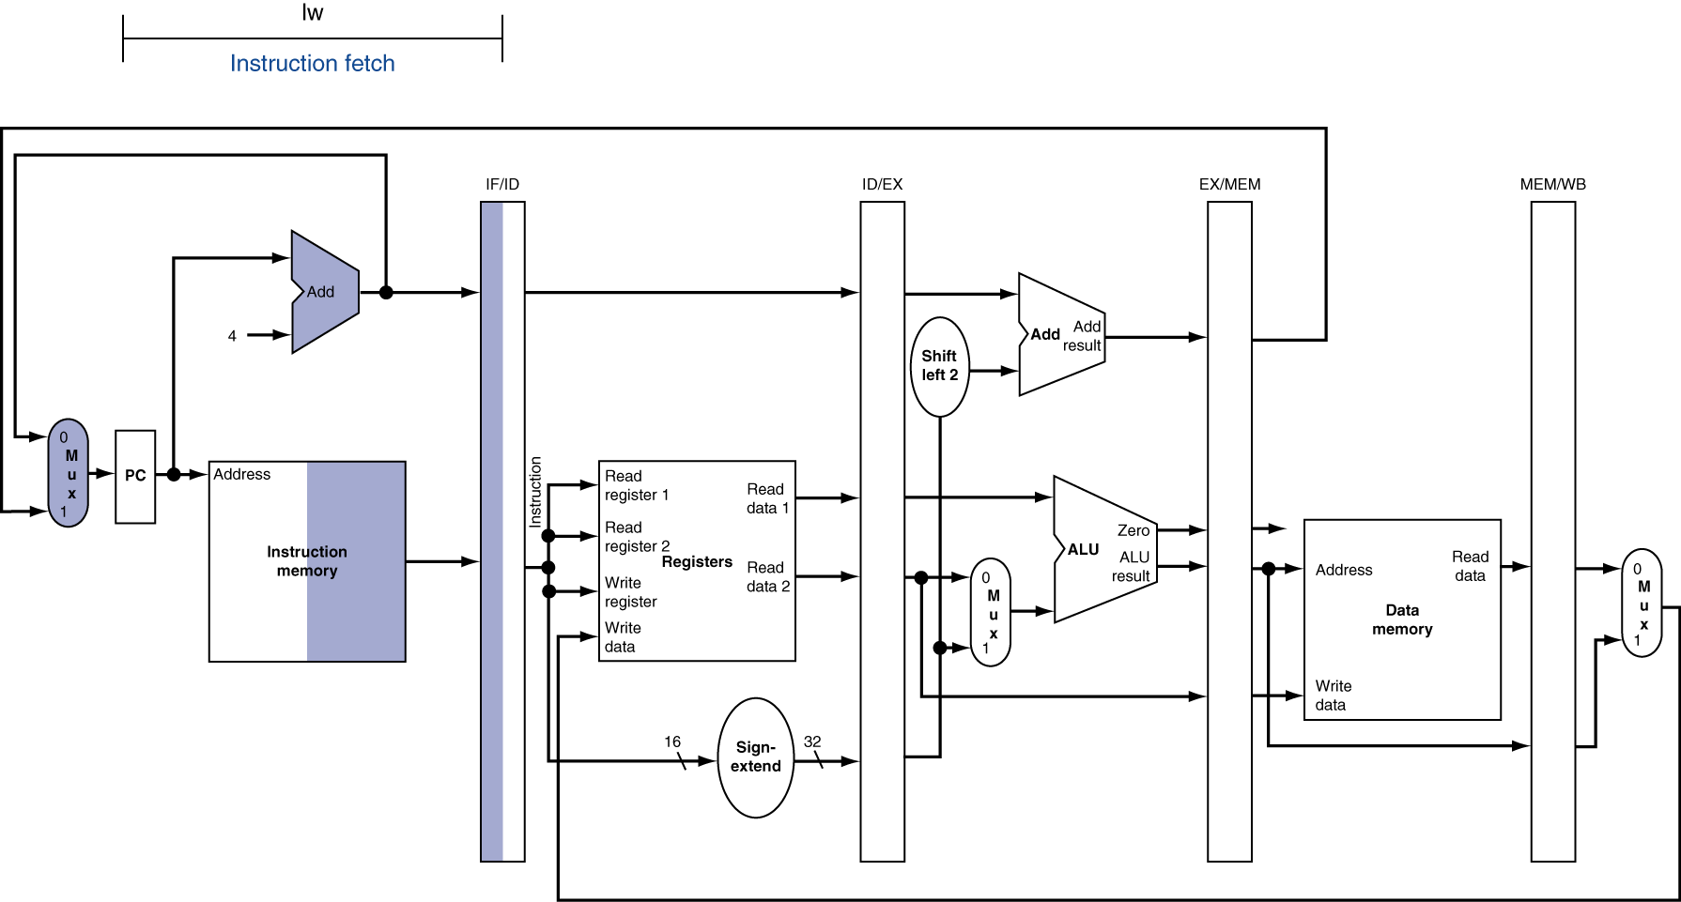
IF for Load, Store, …
Chapter 4 — The Processor — <number>
Notes:
Morgan Kaufmann Publishers
Chapter 4 — The Processor

Slide 58
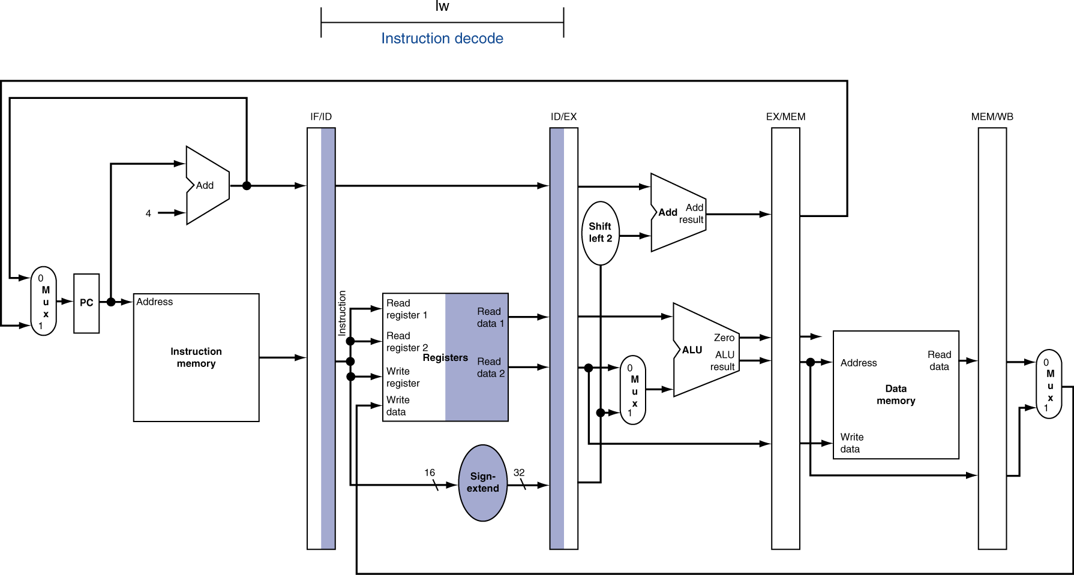
ID for Load, Store, …
Chapter 4 — The Processor — <number>
Notes:
Morgan Kaufmann Publishers
Chapter 4 — The Processor

Slide 59
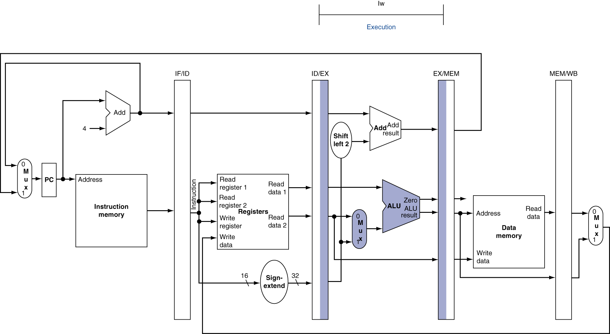
EX for Load
Chapter 4 — The Processor — <number>
Notes:
Morgan Kaufmann Publishers
Chapter 4 — The Processor

Slide 60
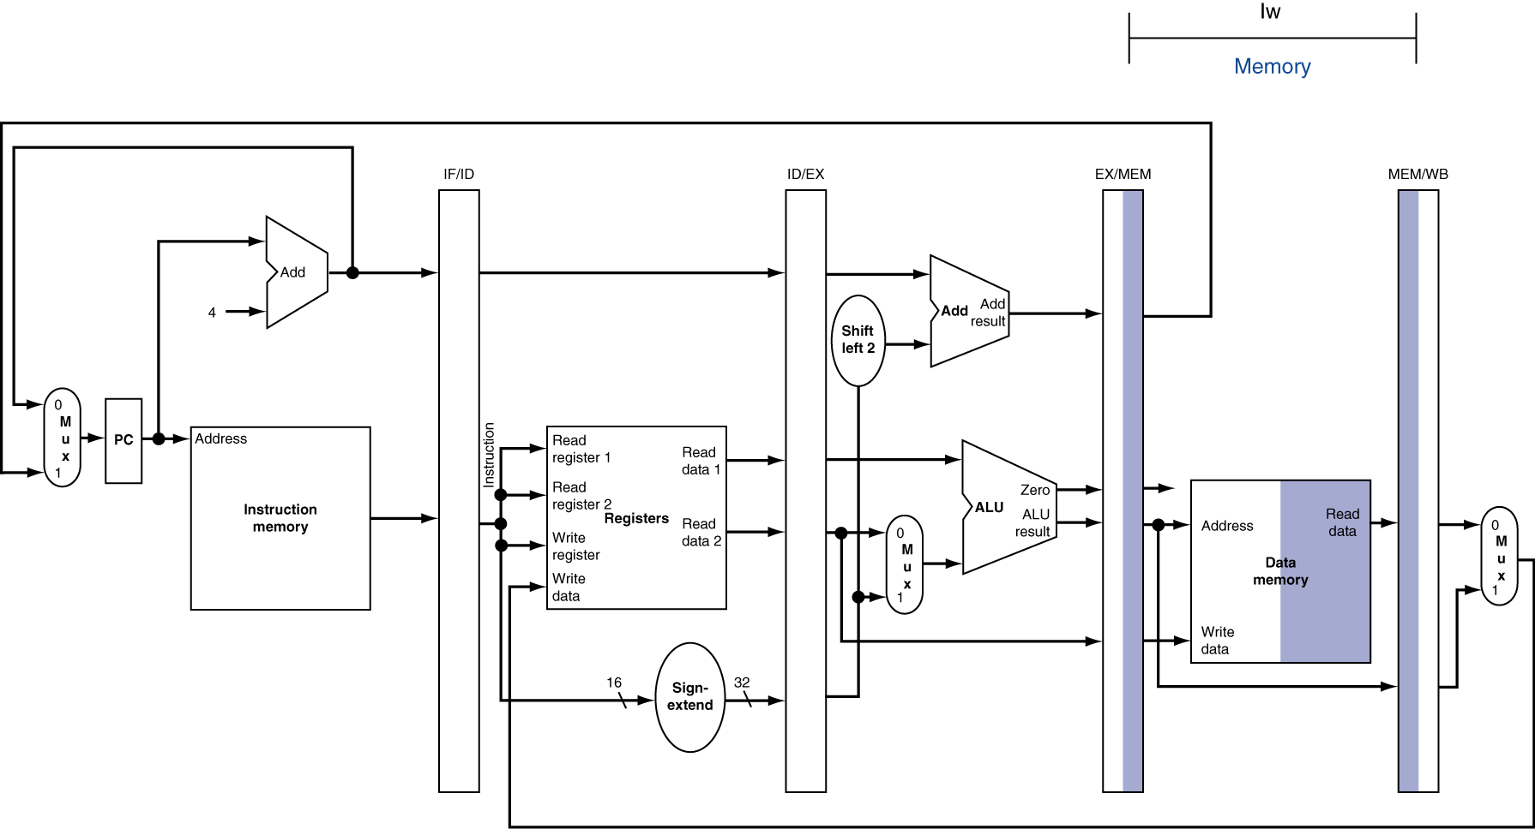
MEM for Load
Chapter 4 — The Processor — <number>
Notes:
Morgan Kaufmann Publishers
Chapter 4 — The Processor

Slide 61
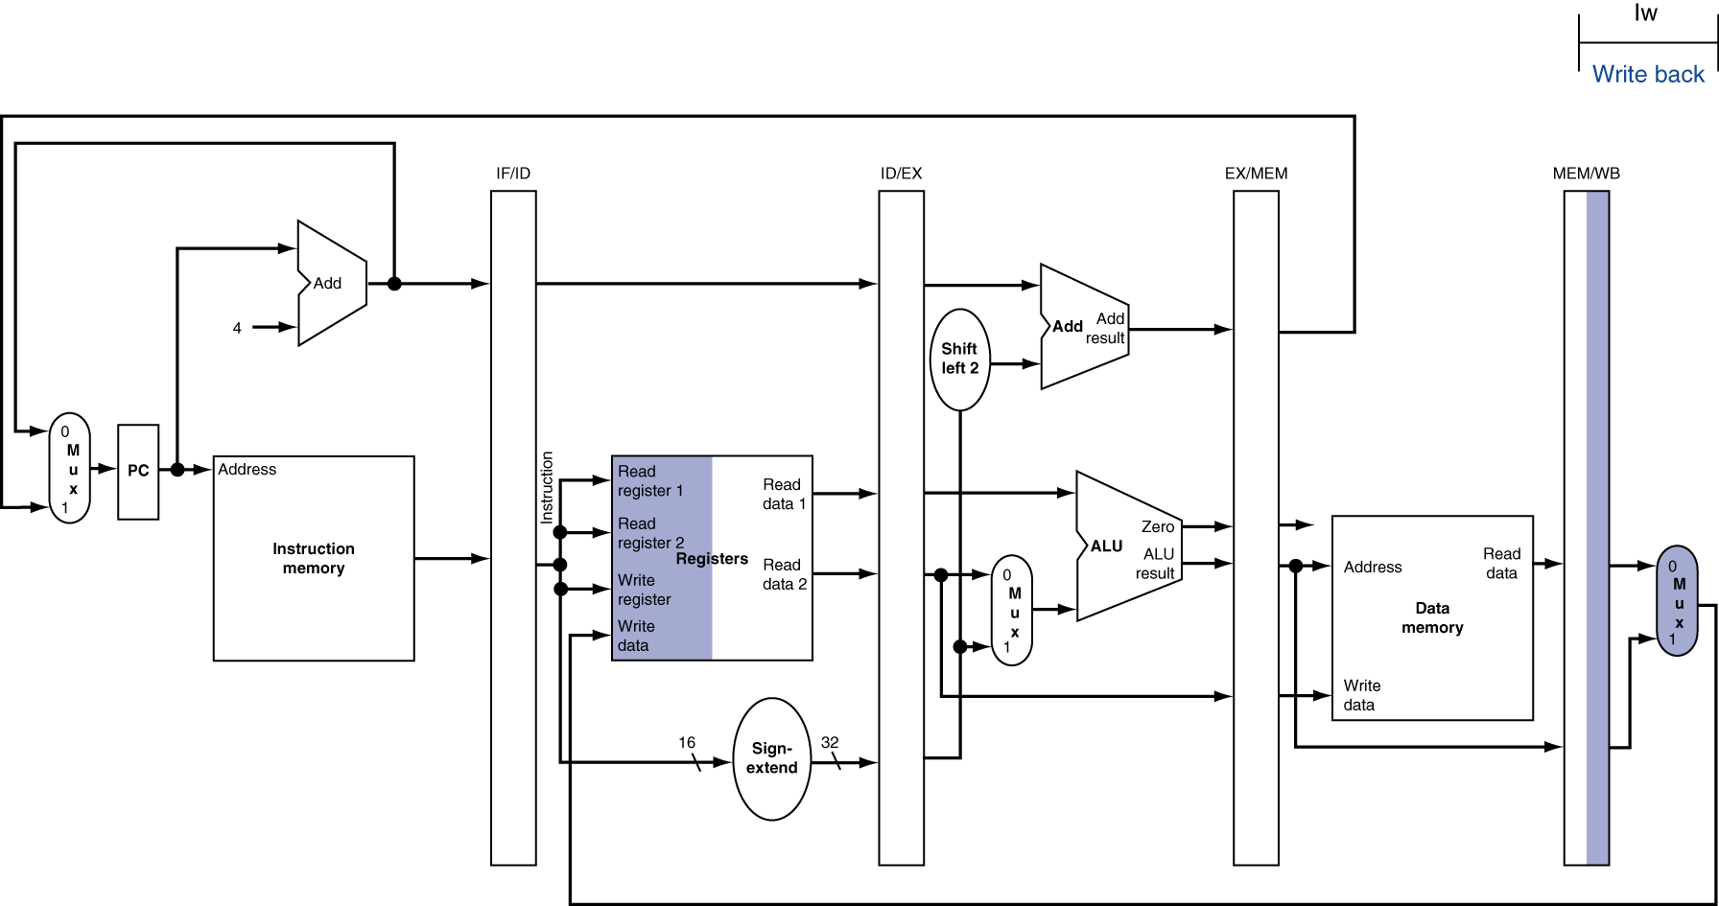
WB for Load
Wrong
register
number
Chapter 4 — The Processor — <number>
Notes:
Morgan Kaufmann Publishers
Chapter 4 — The Processor

Slide 62
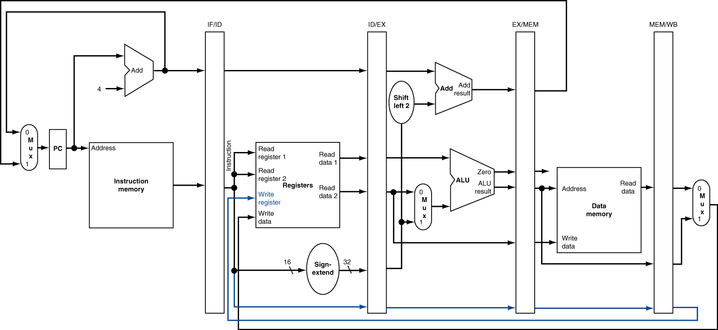
Corrected Datapath for Load
Chapter 4 — The Processor — <number>
Notes:
Morgan Kaufmann Publishers
Chapter 4 — The Processor

Slide 63
IF for Load, Store, …
Chapter 4 — The Processor — <number>
Notes:
Morgan Kaufmann Publishers
Chapter 4 — The Processor

Slide 64
ID for Load, Store, …
Chapter 4 — The Processor — <number>
Notes:
Morgan Kaufmann Publishers
Chapter 4 — The Processor

Slide 65

EX for Store
Chapter 4 — The Processor — <number>
Notes:
Morgan Kaufmann Publishers
Chapter 4 — The Processor

Slide 66
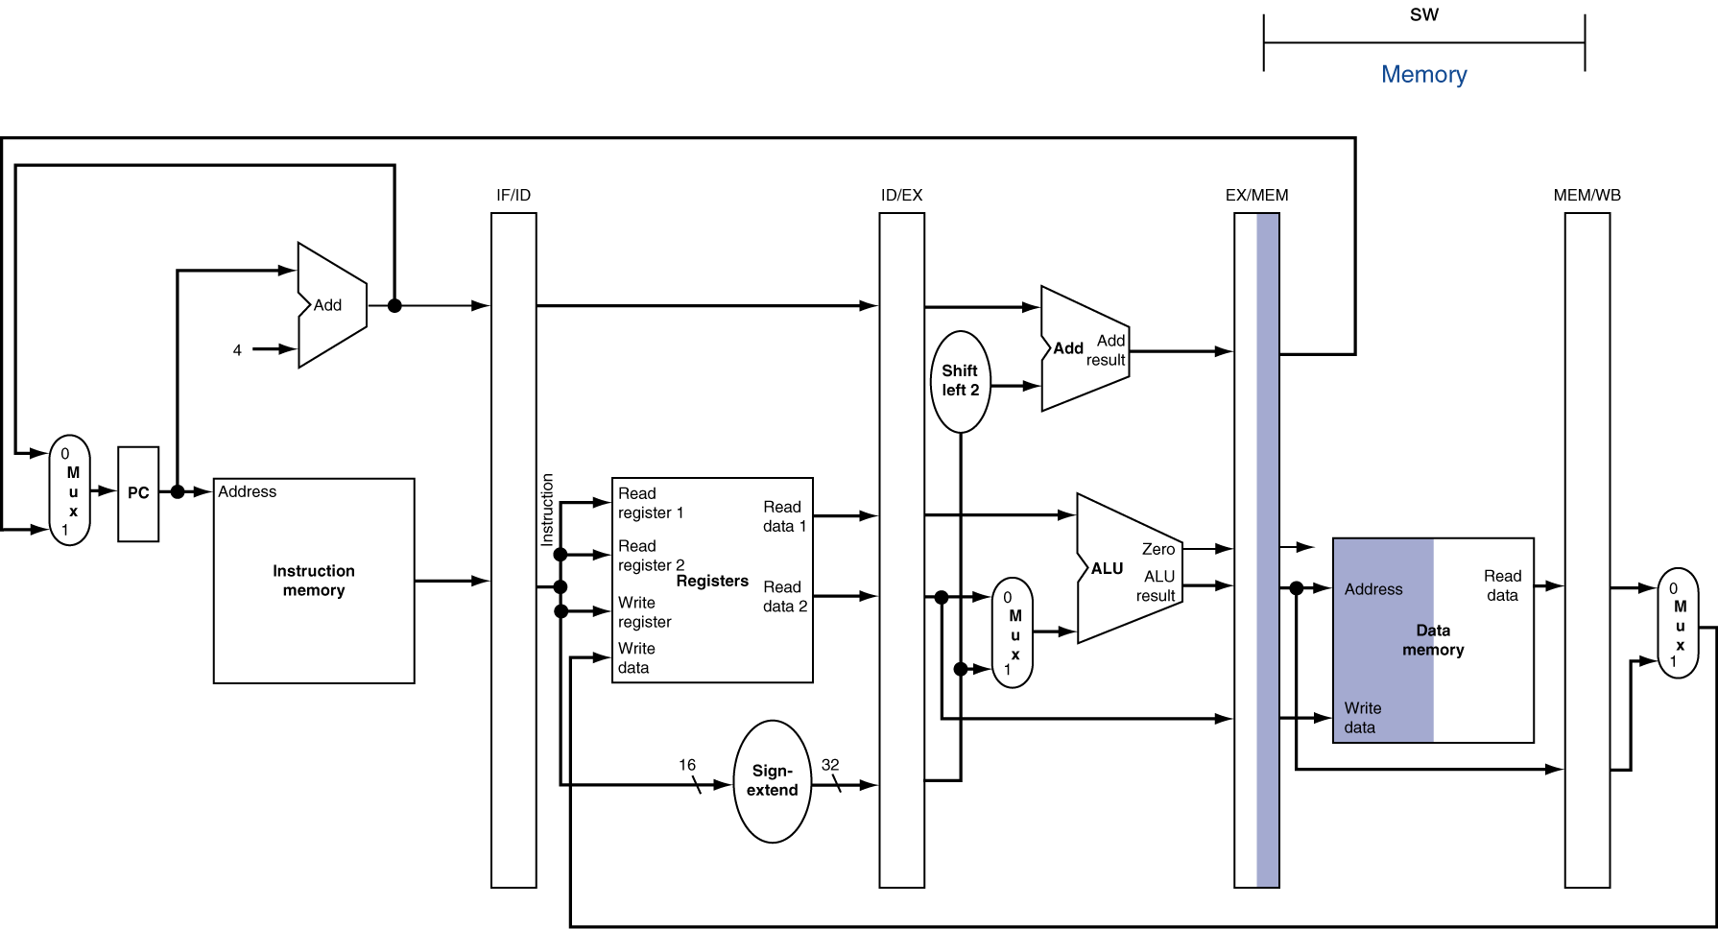
MEM for Store
Chapter 4 — The Processor — <number>
Notes:
Morgan Kaufmann Publishers
Chapter 4 — The Processor

Slide 67
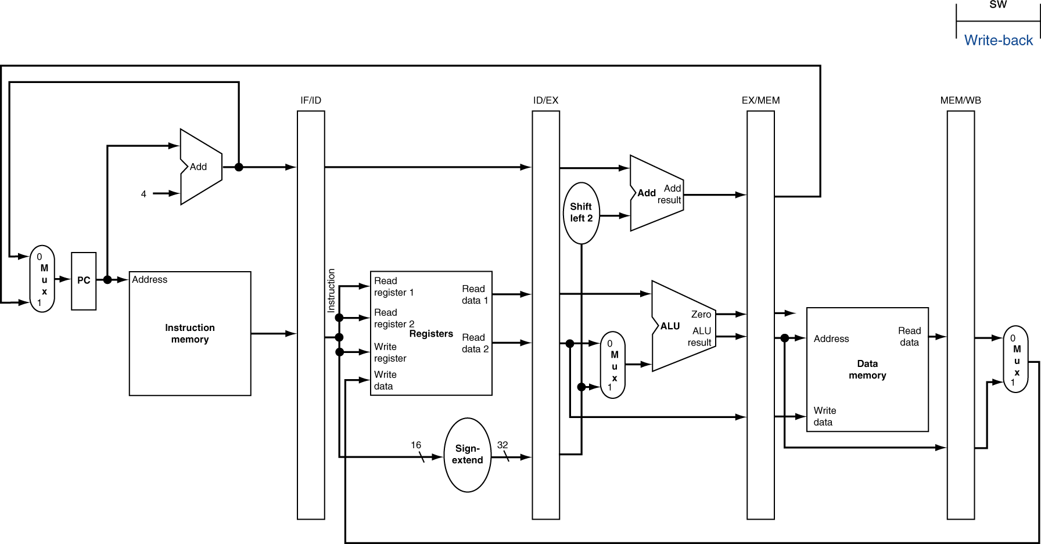
WB for Store
Chapter 4 — The Processor — <number>
Notes:
Morgan Kaufmann Publishers
Chapter 4 — The Processor

Slide 68
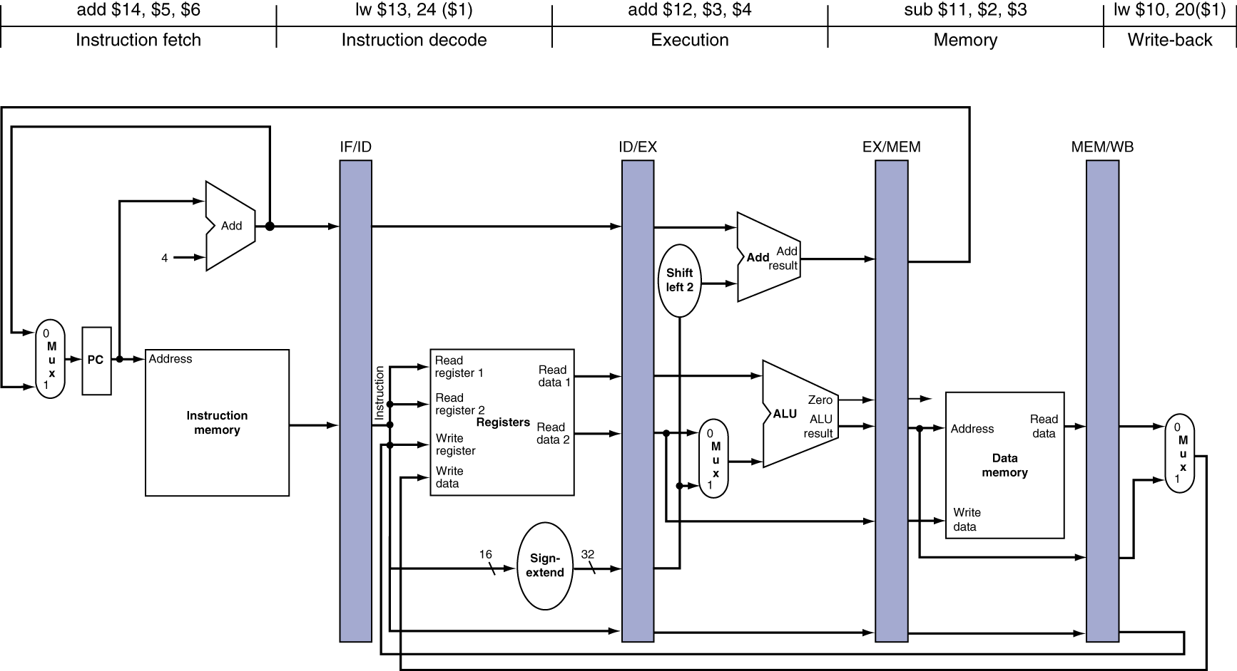
Single-Cycle Pipeline Diagram
State of pipeline in a given cycle
Chapter 4 — The Processor — <number>
Notes:
Morgan Kaufmann Publishers
Chapter 4 — The Processor

Slide 69
Pipeline Summary
The BIG Picture
Pipelining improves performance by increasing instruction throughput
  Executes multiple instructions in parallel
  Each instruction has the same latency
Subject to hazards
  Structure, data, control
Instruction set design affects complexity of pipeline implementation
Chapter 4 — The Processor — <number>
Notes:
Morgan Kaufmann Publishers
Chapter 4 — The Processor

